Slide 1
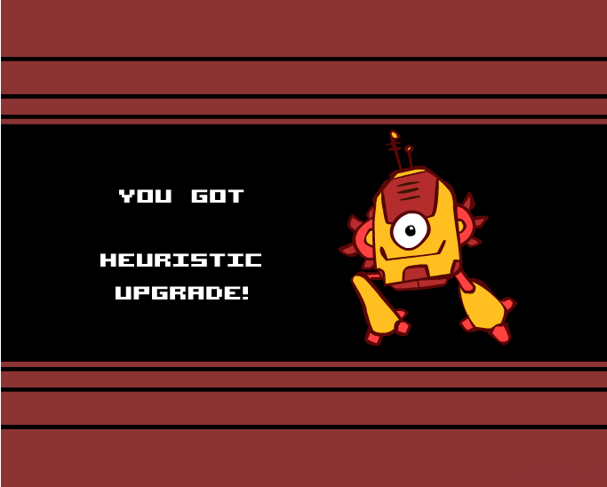

Creating Heuristics

Slide 2

Creating Admissible Heuristics
Most of the work in solving hard search problems optimally is in coming up with admissible heuristics
Often, admissible heuristics are solutions to relaxed problems, where new actions are available
Inadmissible heuristics are often useful too
366
15

Slide 3
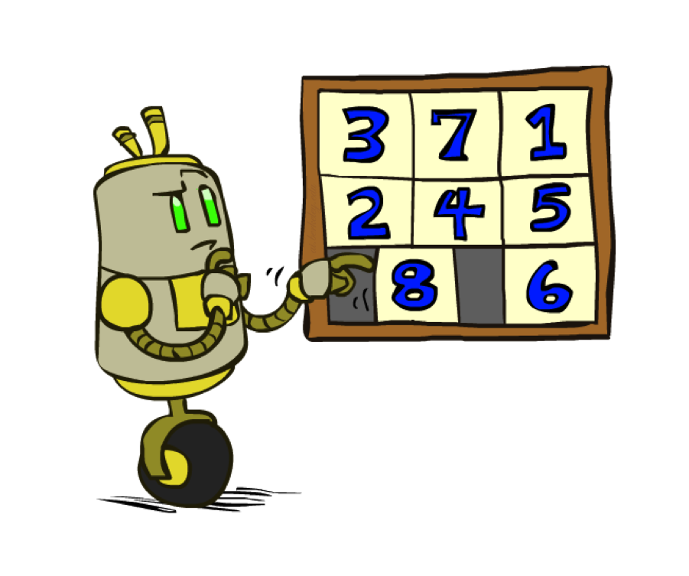
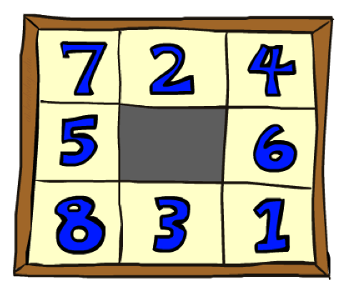
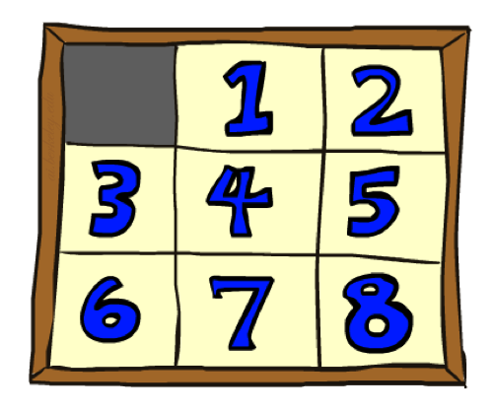
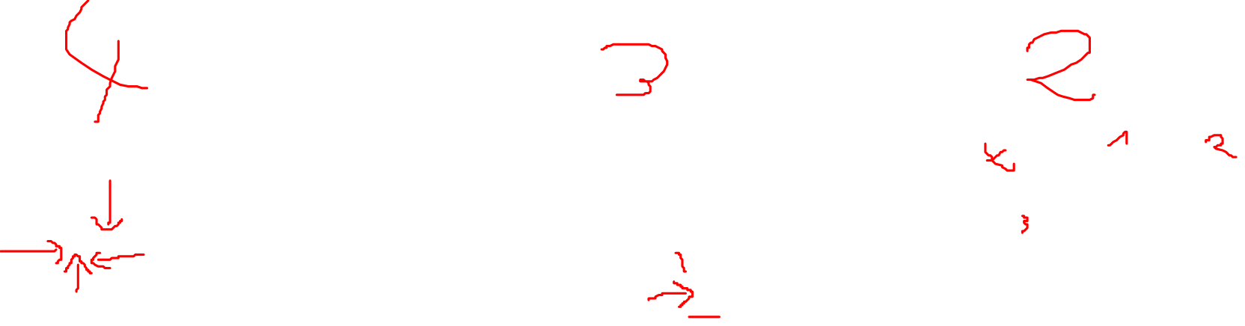
Example: 8 Puzzle
Start State
Actions
Goal State
What are the states?
How many states?
What are the actions?
How many successors from the start state?
What should the costs be?

Slide 4
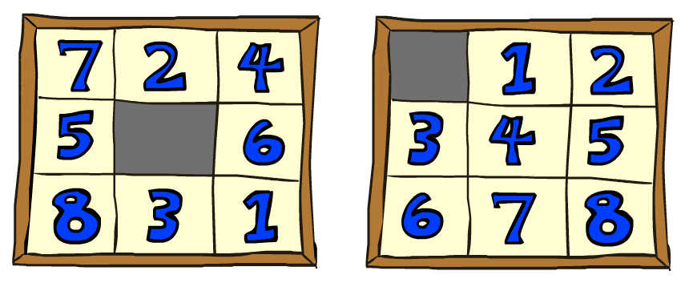
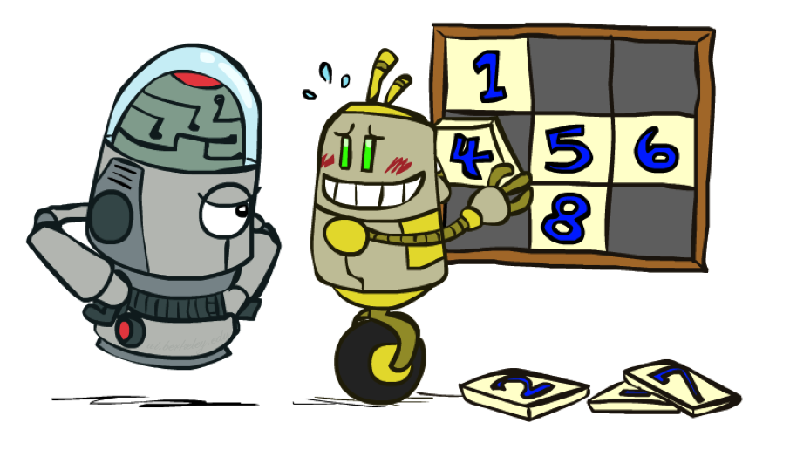
8 Puzzle I
Heuristic: Number of tiles misplaced
Why is it admissible?
h(start) =
This is a relaxed-problem heuristic
8
Start State
Goal State
 | Average nodes expanded when the optimal path has…
 | …4 steps | …8 steps | …12 steps
UCS | 112 | 6,300 | 3.6 x 10⁶
TILES | 13 | 39 | 227
Statistics from Andrew Moore

Slide 5
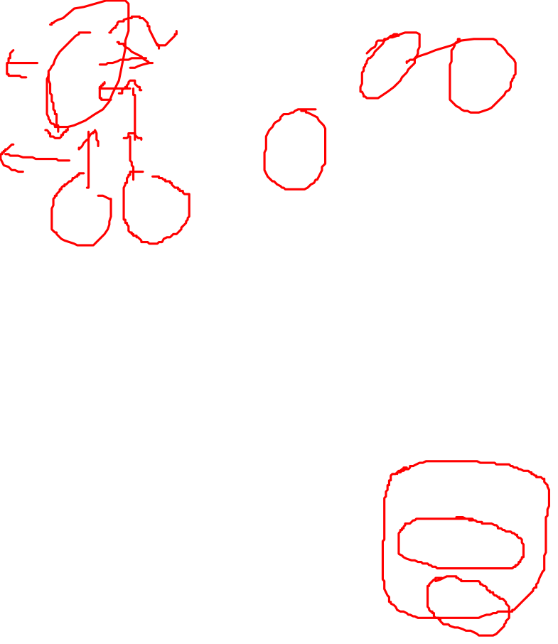
8 Puzzle II
What if we had an easier 8-puzzle where any tile could slide any direction at any time, ignoring other tiles?
Total Manhattan distance
Why is it admissible?
h(start) =
Start State
Goal State
 | Average nodes expanded when the optimal path has…
 | …4 steps | …8 steps | …12 steps
TILES | 13 | 39 | 227
MANHATTAN | 12 | 25 | 73
3 + 1 + 2 + … = 18

Slide 6
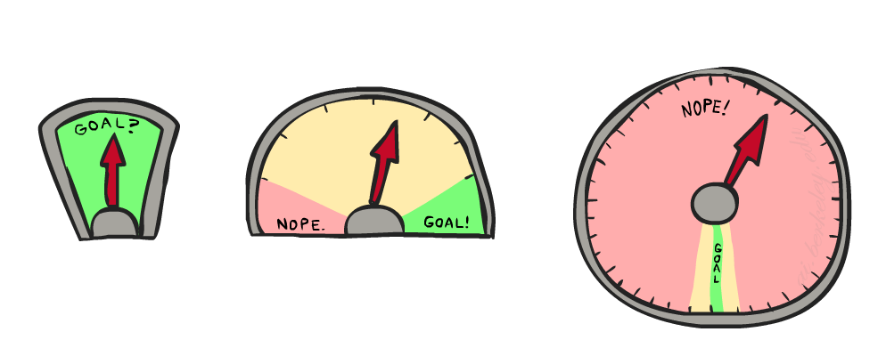
8 Puzzle III
How about using the actual cost as a heuristic?
Would it be admissible?
Would we save on nodes expanded?
What’s wrong with it?
With A*: a trade-off between quality of estimate and work per node
As heuristics get closer to the true cost, you will expand fewer nodes but usually do more work per node to compute the heuristic itself

